Slide 1
Advanced SQL
Lecture 16

Slide 2
Comparisons Involving NULL and Three-Valued Logic
NULL
Unknown value
Unavailable or withheld value
Not applicable attribute
Each individual NULL value considered to be different from every other NULL value
SQL uses a three-valued logic: TRUE, FALSE, and UNKNOWN

Slide 3
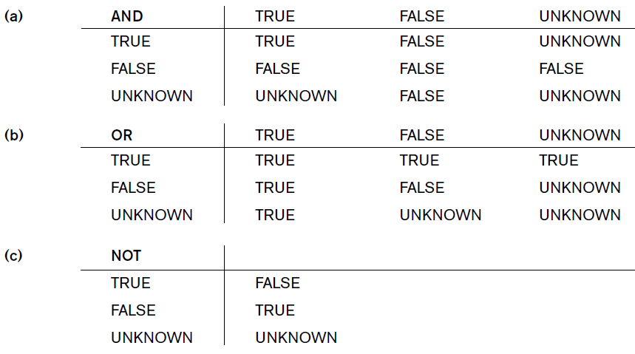
Logical Connectives in Three – Valued Logic

Slide 4
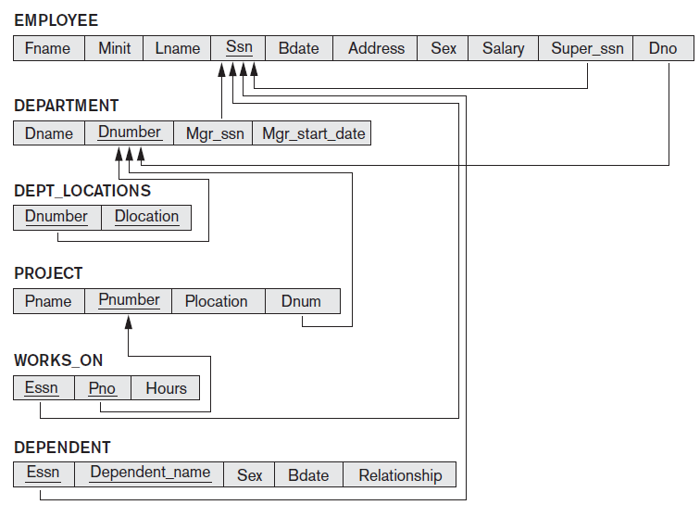
COMPANY Database

Slide 5
Comparisons Involving NULL and Three-Valued Logic (cont’d.)
SQL allows queries that check whether an attribute value is NULL: IS or IS NOT NULL
Example: Retrieve the names of all employees who do not have supervisors.
Query:
SELECT Fname, Lname
FROM EMPLOYEE
WHERE Super_ssn IS NULL;

Slide 6

Nested Queries, Tuples, and Set/ Multiset Comparisons
Nested Queries: Complete select-from-where blocks within WHERE clause of another query
Nested Queries generally return a table (relation)
Comparison operator IN
Compares value v with a set (or multiset) of values V
Evaluates to TRUE if v is one of the elements in V

Slide 7
Example - Nested Queries
Make a list of all project numbers for projects that involve an employee whose last name is ‘Smith’, either as a worker or as a manager of the department that controls the project.
Query:
SELECT DISTINCT Pnumber
FROM PROJECT
WHERE Pnumber IN
( SELECT Pnumber
FROM PROJECT, DEPARTMENT, EMPLOYEE
WHERE Dnum=Dnumber AND
Mgr_ssn=Ssn AND Lname=‘Smith’ )
OR
Pnumber IN
( SELECT Pno
FROM WORKS_ON, EMPLOYEE
WHERE Essn=Ssn AND Lname=‘Smith’ );
Selects the project numbers of projects that have an employee with last name ‘Smith’ involved as manager
Selects the project numbers of projects that have an employee with last name ‘Smith’ involved as worker

Slide 8
Example - Nested Queries (Cont.)
Select the Essns of all employees who work on the same project and hours as some project that employee ‘John Smith’ (whose Ssn = ‘123456789’) works on.
Query:
SELECT DISTINCT Essn
FROM WORKS_ON
WHERE (Pno, Hours) IN ( SELECT Pno, Hours
FROM WORKS_ON
WHERE Essn=‘123456789’ );
Parentheses important to compare combination of Pno and Hours attributes

Slide 9

Comparison Operators to Compare a single value – ANY & ALL
= ANY (or = SOME) operator: Returns TRUE if the value v is equal to some value in the set V (equivalent to IN)
ALL operator: (v > ALL V) returns TRUE if the value v is greater than all the values in the set (or multiset) V.
Other operators that can be combined with ANY (or SOME) and ALL: >, >=, <, <=, and <>

Slide 10
Example - ALL Operator
Return the names of employees whose salary is greater than the salary of all the employees in department 5
Query:
SELECT Lname, Fname
FROM EMPLOYEE
WHERE Salary > ALL ( SELECT Salary
FROM EMPLOYEE
WHERE Dno=5 );

Slide 11


Ambiguity in Nested Queries
Possible ambiguity among attribute names if attributes of the same name exist—one in a relation in the FROM clause of the outer query, and another in a relation in the FROM clause of the nested query.
Thumb Rule: reference to an unqualified attribute refers to the relation declared in the innermost nested query.

Slide 12
Example - Ambiguity in Nested Queries
Retrieve the name of each employee who has a dependent with the same first name and is the same sex as the employee.
Query:
SELECT E.Fname, E.Lname
FROM EMPLOYEE AS E
WHERE E.Ssn IN ( SELECT Essn
FROM DEPENDENT AS D WHERE E.Fname = Dependent_name
AND E.Sex = Sex);
We must qualify E.Sex because it refers to the Sex attribute of EMPLOYEE from the outer query, and DEPENDENT also has an attribute Sex.
Here, the unqualified references to Sex in the nested query, refer to the Sex attribute of DEPENDENT
No need to qualify Fname and Ssn of EMPLOYEE if they appeared in the nested query because the DEPENDENT relation does not have Fname and Ssn attributes, so there is no ambiguity.

Slide 13

Correlated Nested Queries
Whenever a condition in the WHERE clause of a nested query references some attribute of a relation declared in the outer query, the two queries are said to be correlated.
In a correlated query, the nested query is evaluated once for each tuple (or combination of tuples) in the outer query

Slide 14
Example - Correlated Nested Queries
Retrieve the name of each employee who has a dependent with the same first name and is the same sex as the employee.
Query:
SELECT E.Fname, E.Lname
FROM EMPLOYEE AS E
WHERE E.Ssn IN ( SELECT Essn
FROM DEPENDENT AS D WHERE E.Fname = D.Dependent_name
AND E.Sex = D.Sex);
For each EMPLOYEE tuple, evaluate the nested query, which retrieves the Essn values for all DEPENDENT tuples with the same sex and name as that EMPLOYEE tuple.
If the Ssn value of the EMPLOYEE tuple is in the result of the nested query, then select that EMPLOYEE tuple

Slide 15
Nested Queries (Cont.)
Retrieve the name of each employee who has a dependent with the same first name and is the same sex as the employee.
SELECT E.Fname, E.Lname
FROM EMPLOYEE AS E
WHERE E.Ssn IN ( SELECT Essn
FROM DEPENDENT AS D WHERE E.Fname = D.Dependent_name
AND E.Sex = D.Sex);
=========================
SELECT E.Fname, E.Lname
FROM EMPLOYEE AS E, DEPENDENT AS D
WHERE E.Ssn=D.Essn AND E.Sex=D.Sex
AND E.Fname=D.Dependent_name;

Slide 16

EXISTS Function
EXISTS function: Check whether the result of a
correlated nested query is empty or not
EXISTS and NOT EXISTS are typically used in conjunction with a correlated nested query
EXISTS(Q): returns TRUE if there is at least one tuple in the result of the nested query Q, and it returns FALSE otherwise.
NOT EXISTS(Q): returns TRUE if there are no tuples in the result of nested query Q, and it returns FALSE otherwise.

Slide 17
Example – EXISTS
For each EMPLOYEE tuple, evaluate the nested query, which retrieves all DEPENDENT tuples with the same Essn, Sex, and Dependent_name as the EMPLOYEE tuple.
If at least one tuple EXISTS in the result of the nested query, then select that EMPLOYEE tuple.
Retrieve the name of each employee who
has a dependent with the same first
name and is the same sex as the employee.
SELECT E.Fname, E.Lname
FROM EMPLOYEE AS E
WHERE E.Ssn IN ( SELECT Essn
FROM DEPENDENT AS D WHERE E.Fname = D.Dependent_name
AND E.Sex = D.Sex);
======================
SELECT E.Fname, E.Lname
FROM EMPLOYEE AS E
WHERE EXISTS ( SELECT *
FROM DEPENDENT AS D
WHERE E.Ssn=D.Essn AND E.Sex=D.Sex AND E.Fname=D.Dependent_name);

Slide 18
Example – NOT EXISTS
Retrieve the names of employees who have no dependents.
Query:
SELECT Fname, Lname
FROM EMPLOYEE
WHERE NOT EXISTS ( SELECT *
FROM DEPENDENT WHERE Ssn=Essn );
For each EMPLOYEE tuple, the correlated nested query selects all DEPENDENT tuples whose Essn value matches the EMPLOYEE Ssn.
If the result is empty, no dependents are related to the employee, so we select that EMPLOYEE tuple and retrieve its Fname and Lname.

Slide 19
COMPANY Database

Slide 20

Practice Drill
List the names of managers who have at least one dependent using EXISTS and NOT EXISTS functions
Retrieve the name of each employee who works on all the projects controlled by department number 5 using EXISTS and NOT EXISTS functions

Slide 21
Solution – Practice Drill
List the names of managers who have at least one dependent
SELECT Fname, Lname
FROM EMPLOYEE
WHERE EXISTS ( SELECT *
FROM DEPENDENT
WHERE Ssn=Essn )
AND EXISTS ( SELECT *
FROM DEPARTMENT WHERE Ssn=Mgr_ssn );
Selects all DEPENDENT tuples related to an EMPLOYEE
Selects all DEPARTMENT tuples managed by the EMPLOYEE

Slide 22
Solution – Practice Drill
Retrieve the name of each employee who works on all the projects controlled by department number 5
SELECT Fname, Lname
FROM EMPLOYEE
WHERE NOT EXISTS ( ( SELECT Pnumber
FROM PROJECT
WHERE Dnum=5)
EXCEPT ( SELECT Pno
FROM WORKS_ON WHERE Ssn=Essn) )
Selects all projects controlled by department 5 (not correlated to outer query),
Selects all projects that the particular employee being considered works on (correlated to outer query)
If the set difference of the first subquery result MINUS (EXCEPT) the second subquery result is empty, it means that the employee works on all the projects and is therefore selected.

Slide 23

Solution – Practice Drill
Retrieve the name of each employee who works on all the projects controlled by department number 5
SELECT Lname, Fname
FROM EMPLOYEE
WHERE NOT EXISTS ( SELECT *
FROM WORKS_ON B
WHERE ( B.Pno IN ( SELECT Pnumber
FROM PROJECT WHERE Dnum=5 ) AND NOT EXISTS ( SELECT *
FROM WORKS_ON C WHERE C.Essn=Ssn AND C.Pno=B.Pno )));
Notes:
The outer nested query selects any WORKS_ON (B) tuples whose Pno is of a project controlled by department 5, if there is not a WORKS_ON (C) tuple with the same Pno and the same Ssn as that of the EMPLOYEE tuple under consideration in the outer query. If no such tuple exists, we select the EMPLOYEE tuple.

Slide 24
UNIQUE Function
UNIQUE(Q): Returns TRUE if there are no duplicate tuples in the result of query Q
Example:
SELECT FName, LName
FROM EMPLOYEE
WHERE UNIQUE (SELECT ESsn
FROM WORKS_ON
WHERE WORKS_on.ESsn = EMPLOYEE.Ssn);
Retrieves the names of all employees who work on only one project

Slide 25
Explicit Sets in WHERE Clause
Can use explicit set of values in WHERE clause
Example: Retrieve the Social Security numbers of all employees who work on project numbers 1, 2, or 3.
Query:
SELECT DISTINCT Essn
FROM WORKS_ON
WHERE Pno IN (1, 2, 3);

Slide 26

Renaming of Attributes
Rename any attribute that appears in the result of a query using “AS” qualifier followed by desired new name
Example:
SELECT E.Lname AS Employee_name, S.Lname AS Supervisor_name
FROM EMPLOYEE AS E, EMPLOYEE AS S
WHERE E.Super_ssn=S.Ssn;

Slide 27
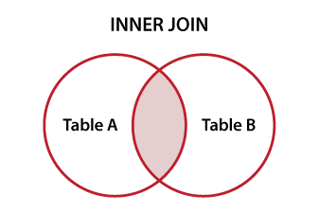
Joined Tables
Joined Table: Permits users to specify a table resulting from a join operation in the FROM clause of a query
The attributes of such a table are all the attributes of the first table followed by all the attributes of the second table.
The default type of join in a joined table is called an inner join, where a tuple is included in the result only if a matching tuple exists in the other relation.

Slide 28
Example - Joined Tables
Retrieve the name and address of every employee who works for the ‘Research’ department.
Query:
SELECT Fname, Lname, Address
FROM (EMPLOYEE JOIN DEPARTMENT ON Dno=Dnumber)
WHERE Dname=‘Research’;

Slide 29

Natural Join
NATURAL JOIN on two relations R and S
No join condition specified
Implicit EQUIJOIN condition for each pair of attributes with same name from R and S
It is possible to rename the attributes so that they match, if the names of the join attributes are not the same in the base relations.

Slide 30
Example – Natural join
Retrieve the name and address of every employee who works for the ‘Research’ department.
Query:
SELECT Fname, Lname, Address
FROM (EMPLOYEE NATURAL JOIN
(DEPARTMENT AS DEPT (Dname, Dno, Mssn, Msdate)))
WHERE Dname=‘Research’;

Slide 31
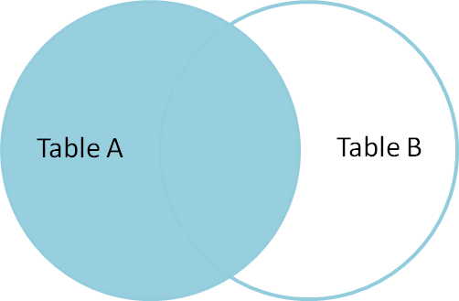
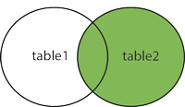
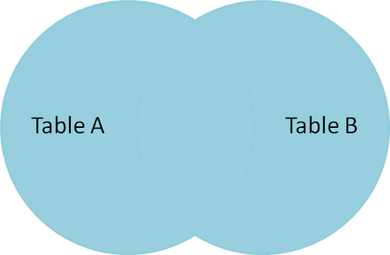
Outer Join
LEFT OUTER JOIN
Every tuple in left table must appear in result
If no matching tuple, padded with NULL values for attributes of right table
RIGHT OUTER JOIN
Every tuple in right table must appear in result
If no matching tuple, padded with NULL values for the attributes of left table
FULL OUTER JOIN
CROSS JOIN – for Cartesian Product

Slide 32

Example – Outer Join
List employees who have a supervisor and for those who do not have supervisor indicate a NULL value
Query:
SELECT E.Lname AS Employee_name, S.Lname AS Supervisor_name
FROM (EMPLOYEE AS E LEFT OUTER JOIN EMPLOYEE AS S
ON E.Super_ssn=S.Ssn);

Slide 33
Nesting with Join Operation
For every project located in ‘Stafford’, list the project number, the controlling department number, and the department manager’s last name, address, and birth date.
Query:
SELECT Pnumber, Dnum, Lname, Address, Bdate
FROM ((PROJECT JOIN DEPARTMENT ON Dnum=Dnumber)
JOIN EMPLOYEE ON Mgr_ssn=Ssn)
WHERE Plocation=‘Stafford’;

Slide 34
COMPANY Database

Slide 35

Aggregate Functions
Used to summarize information
from multiple tuples into a single-tuple summary
Grouping
Create subgroups of tuples before summarizing
Built-in aggregate functions: COUNT, SUM, MAX, MIN, and AVG (NULL values discarded when aggregate functions are applied to a particular column)
Functions can be used in the SELECT clause or in a HAVING clause

Slide 36
Example - Aggregate Functions
Find the sum of the salaries of all employees, the maximum salary, the minimum salary and the average salary.
Query
SELECT SUM (Salary), MAX (Salary), MIN (Salary), AVG (Salary)
FROM EMPLOYEE;
Aggregate Functions

Slide 37
Example - Aggregate Functions (Cont.)
Find the sum of the salaries of all employees of the ‘Research’ department, as well as the maximum salary, the minimum salary, and the average salary in this department.
Query
SELECT SUM (Salary), MAX (Salary), MIN (Salary), AVG (Salary)
FROM (EMPLOYEE JOIN DEPARTMENT ON Dno=Dnumber)
WHERE Dname=‘Research’;
Aggregate Functions

Slide 38
Example - Aggregate Functions (Cont.)
Retrieve the number of employees in the ‘Research’ department
Query
SELECT COUNT ( * )
FROM EMPLOYEE, DEPARTMENT
WHERE DNO=DNUMBER AND DNAME=‘Research’;
Aggregate Functions
Refers to the rows

Slide 39
Example - Aggregate Functions (Cont.)
Count the number of distinct salary values in the database.
Query
SELECT COUNT (DISTINCT Salary)
FROM EMPLOYEE;
Aggregate Functions
(will not count tuples with NULL)
Eliminates duplicate values

Slide 40
Example - Aggregate Functions (Cont.)
Retrieve the names of all employees who have two or more dependents
Query
SELECT Lname, Fname
FROM EMPLOYEE
WHERE ( SELECT COUNT (*)
FROM DEPENDENT
WHERE Ssn=Essn ) >= 2;
Aggregate Functions
Counts the number of dependents that each employee has; if this is greater than or equal to two, the employee tuple is selected

Slide 41

The GROUP BY and HAVING Clauses
Partition relation into subsets of tuples
Based on grouping attribute(s)
Apply function to each such group independently
GROUP BY clause: Specifies grouping attributes
If NULLs exist in grouping attribute
Separate group created for all tuples with
a NULL value in grouping attribute
HAVING clause
Provides a condition on the summary
information

Slide 42
Example
For each department, retrieve the department number, the number of employees in the department, and their average salary.
Query:
SELECT Dno, COUNT (*), AVG (Salary)
FROM EMPLOYEE
GROUP BY Dno;
SELECT clause includes only the grouping attribute and the aggregate functions to be applied on each group of tuples.

Slide 43
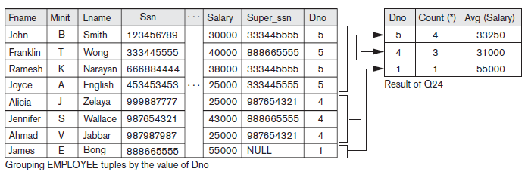
Result

Slide 44

Example
For each project, retrieve the project number, the project name and the number of employees who work on that project.
Query:
SELECT Pnumber, Pname, COUNT (*)
FROM PROJECT, WORKS_ON
WHERE Pnumber=Pno
GROUP BY Pnumber, Pname;

Slide 45
Example
For each project on which more than two employees work, retrieve the project number, the project name, and the number of employees who work on the project.
Query:
SELECT Pnumber, Pname, COUNT (*)
FROM PROJECT, WORKS_ON
WHERE Pnumber=Pno
GROUP BY Pnumber, Pname
HAVING COUNT (*) > 2;
WHERE clause limit the tuples to which functions are applied, the HAVING clause serves to choose whole groups

Slide 46
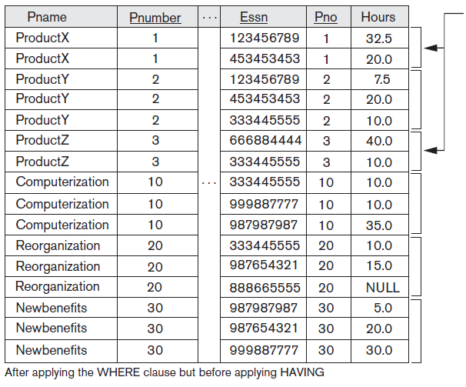
Result
These groups are not selected by
the HAVING condition

Slide 47
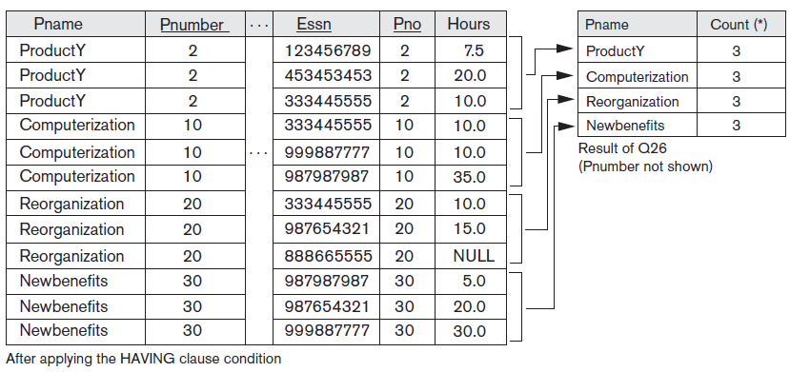
Result (Cont.)

Slide 48

Example
For each project, retrieve the project number, the project name and the number of employees from department 5 who work on the project.
Query:
SELECT Pnumber, Pname, COUNT (*)
FROM PROJECT, WORKS_ON, EMPLOYEE
WHERE Pnumber=Pno AND Ssn=Essn AND Dno=5
GROUP BY Pnumber, Pname;

Slide 49

Example
Count the total number of employees whose salaries exceed $40,000 in each department, but only for departments where more than five employees work.
Query:
SELECT Dname, COUNT (*)
FROM DEPARTMENT, EMPLOYEE
WHERE Dnumber=Dno AND Salary>40000
GROUP BY Dname
HAVING COUNT (*) > 5;
It will select only departments that have more than five employees who each earn more than $40,000. The tuples are already restricted to employees who earn more than $40,000 before the function in the HAVING clause is applied.

Slide 50

Example (Cont.)
SELECT Dnumber, COUNT (*)
FROM DEPARTMENT, EMPLOYEE
WHERE Dnumber=Dno AND Salary>40000 AND
( SELECT Dno
FROM EMPLOYEE
GROUP BY Dno
HAVING COUNT (*) > 5)
For each department that has more than five employees, retrieve the department number and the number of its employees who are making more than $40,000.

Slide 51

Summarization of SQL Queries & Execution Sequence
5. SELECT <attribute and function list>
1. FROM <table list>
2. [ WHERE <condition> ]
3. [ GROUP BY <grouping attribute(s)> ]
4. [ HAVING <group condition> ]
6. [ ORDER BY <attribute list> ];

Slide 52
DROP Command
Used to drop named schema elements, such as tables, domains, or constraint
Drop behavior options:
CASCADE and RESTRICT
Example:
DROP SCHEMA COMPANY CASCADE;
Removes the COMPANY database schema and all its tables, domains, and other elements

Slide 53
DROP Command Example
DROP SCHEMA COMPANY RESTRICT
DROP TABLE DEPENDENT CASCADE
not only deletes all the records in the table if successful, but also removes the table definition from the catalog
schema is dropped only if it has no elements in it; otherwise, the DROP command will not be executed

Slide 54
ALTER Command
Alter table actions include:
Adding or dropping a column (attribute)
Changing a column definition
Adding or dropping table constraints
Example:
ALTER TABLE COMPANY.EMPLOYEE ADD COLUMN Job VARCHAR(12);

Slide 55
Example - ALTER Command
ALTER TABLE COMPANY.EMPLOYEE DROP COLUMN Address CASCADE;
ALTER TABLE COMPANY.DEPARTMENT ALTER COLUMN Mgr_ssn DROP DEFAULT;
ALTER TABLE COMPANY.DEPARTMENT ALTER COLUMN Mgr_ssn SET DEFAULT ‘333445555’
ALTER TABLE COMPANY.EMPLOYEE DROP CONSTRAINT EMPSUPERFK CASCADE

Slide 56

Specifying Constraints as Assertions
CREATE ASSERTION
DDL command that specifies additional type of constraints outside the scope of built-in relational model constraints
Each assertion is given a constraint name and is specified via a condition

Slide 57
Example - Assertions
Specify the constraint that the salary of an employee must not be greater than the salary of the manager of the department that the employee works for.
Query:
CREATE ASSERTION SALARY_CONSTRAINT
CHECK ( NOT EXISTS ( SELECT *
FROM EMPLOYEE E, EMPLOYEE M, DEPARTMENT D
WHERE E.Salary>M.Salary AND E.Dno=D.Dnumber AND D.Mgr_ssn=M.Ssn ) )
Name of Constraint

Slide 58

Stored Procedures
A stored procedure is a SQL code that can be saved and reused again and again.
Parameters can be passed to a stored procedure, based on which the stored procedure can act.
Syntax:
CREATE PROCEDURE procedure_name AS sql_statement GO;
Execution:
EXEC procedure_name;

Slide 59
Example – Stored Procedures
Create a stored procedure "SelectAllEmployees" that selects all records from the “EMPLOYEE" table.
Query:
CREATE PROCEDURE SelectAllEmployees AS SELECT * FROM EMPLOYEE GO;
Execution:
EXEC SelectAllEmployees;

Slide 60

Specifying Actions as Triggers
CREATE TRIGGER
Specifies automatic actions that database system will perform when certain events and conditions occur
To monitor the database
Typical trigger has three components:
Event(s)
Condition
Action

Slide 61
Example - Triggers
Check whenever an employee’s salary is greater than the salary of his or her direct supervisor in the COMPANY database and in case of voilation call a stored procedure INFORM_SUPERVISOR
Query:
CREATE TRIGGER SALARY_VIOLATION
BEFORE INSERT OR UPDATE OF SALARY, SUPERVISOR_SSN
ON EMPLOYEE
FOR EACH ROW
WHEN ( NEW.SALARY > ( SELECT SALARY FROM EMPLOYEE
WHERE SSN = NEW.SUPERVISOR_SSN ) )
INFORM_SUPERVISOR(NEW.Supervisor_ssn,
NEW.Ssn );
Event
Condition
Action

Slide 62
Stored Procedure v/s Triggers
Stored Procedure
A stored procedure can be executed anytime.
Stored procedure can take input parameters.
Triggers
A trigger can only be executed when an event (insert, delete, and update) is fired on a table.
Triggers can’t take input parameters.
Stored procedures can return values.
A trigger cannot return a value.
Stored procedures are used for performing tasks.
Triggers are used for auditing work.

Slide 63
Thanks!!

